Slide 1
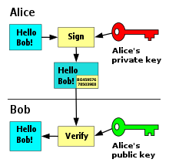
Digital Signatures - PKI
Features
Asymmetric cryptography

Slide 2
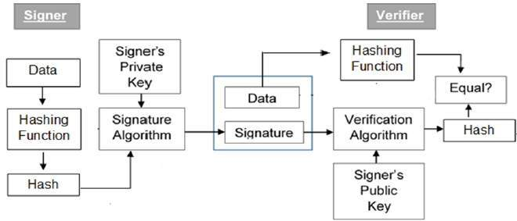
Digital Signatures

Slide 3
Digital Signatures
Digital Signature Definition
Integrity: the message hasn't been altered in transit
Authenticity: the author of the message is really who they claim to be
Non-repudiation: the author of the message can't later deny that they were the source

Slide 4
Digital Signatures
message
Sending Signed Message
A digital signature is the encrypted hash (digest, checksum) of a message
A hash is generated from a message and its encrypted it with a private key according to a chosen algorithm.
The message, the encrypted hash, the corresponding public key, and the algorithm are all then sent.
hash
Priv
Key
Digital Signatures
Encryption (RSA/ECC)

Slide 5
Digital Signatures
message
Signed
Data
Pub key
Receiving and Validating a Digital Signature
The message receiver generates a new hash from the received message
Then the receiver decrypts the received encrypted hash using the public key
Compare the two outputs
Create
Hash
Decryption
Pub key
hash
Output
hash

Slide 6
Digital Signatures
Demonstrate Digital Signatures

